Slide 1
BRITISH AIRWAYS REVIEW ANALYSIS
FORAGE VIRTUAL INTERNSHIP

Slide 2
DATA CLEANING AND PREPARATION
Below are the steps taken to clean and prepare the data for analysis:
Convert all alphabets to lowercase.
Remove punctuation.
Remove stop words.
Remove frequently seen and less common words.
Remove double spaces.
Remove numbers.
Stemming

Slide 3
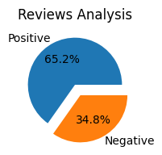
SENTIMENT ANALYSIS
Below is the positive and negative comment distribution of the reviews.
The sentiment analysis is performed using ‘TextBlob’
Overall, there are more positive reviews than negative ones.

Slide 4
TOPIC MODELLING
Topic Modelling identifies the theme of the reviews and extracts the topics being discussed in the reviews.
Latent Direchlet Allocation (LDA) in gensim package is used to extract the main terms used for the review.
Below are the main terms used in the reviews.
[(0, '0.011*"hour" + 0.009*"u" + 0.009*"customer" + 0.009*"british" + 0.008*"airway" + 0.008*"day" + 0.008*"airline" + 0.007*"told" + 0.007*"get" + 0.007*"would“’)]
The words like ‘u’ , ‘told’, ‘get’ ,’would’ do not add much value to recognizing the main theme of the reviews. But the other terms signify some relevance to airline reviews.
This analysis is not much helpful.

Slide 5
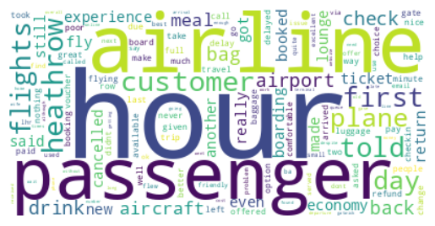
WORDCLOUD
Though Word clouds are useful for visualizing common words in a text or data set, they're usually only useful as a high-level overview of themes.
The Wordcloud package is used to visualize the most common words in the dataset.
Below is the word cloud representation of the reviews in the dataset.
From the image below, the most used words are ‘airline’, ‘hour’, ‘passenger’,’ flight’, ‘Heathrow’, ‘airport’ etc.
The most used words suggest that customers are actively talking about flight experience, delays in flights, reviews about meals etc.

